Slide 1
Global Market Trends Analyzer:
Milestone 1, 2 & 3

Slide 2
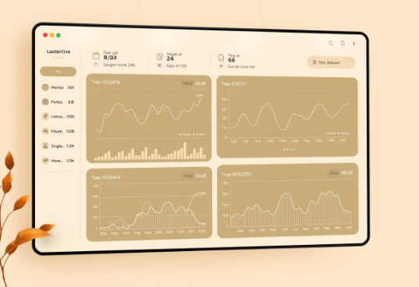
Market Trends Analysis Interface
Overview
Key Features
The Market Trends Analysis Interface is a web application designed to provide an intuitive, secure platform for analyzing financial market trends. It offers a user-friendly experience with a focus on data security and ease of use.
User Management
Registration, login, and logout functionalities with secure password hashing.
Emphasis on data security and usability.
Financial Data Insights
Integration with the Alpha Vantage API for fetching real-time market data.
Search by ticker symbols to retrieve and analyze stock trends.
Interactive Visualization
Charts and graphs to visualize market trends dynamically.
Real-time insights to assist users in financial decision-making.
Technology Stack
Framework
Database
Data Processing
Streamlit
SQLite
Pandas

Slide 3
Milestone 1
Module 1: User Authentication and Registration
Module 2: Market Data Management
Implemented Features:
Functionalities Implemented:
Database schema for market data storage.
User registration and login.
Integrated public APIs for real-time and historical data.
Email verification and password reset.
Profile display with user picture post-login.
Admin dashboard for CRUD operations and graphical market trends.
Security Measures:
Password hashing using SHA256.
Session-based authentication.

Slide 4
Milestone 2
Module 3: Market Trends Analysis
Functionalities Implemented:
Date range selection and specific market indicators.
Machine learning models for trend prediction.
Advanced analytics for insights on market movements.
Technologies Used:
Backend: SQLite, APIs.
Frontend: Streamlit.

Slide 5
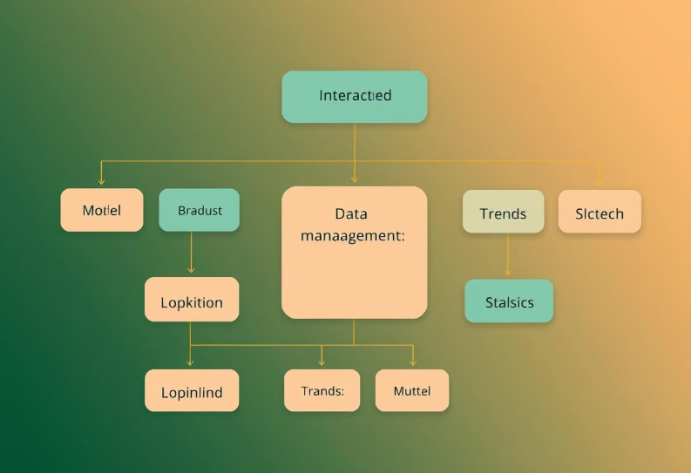
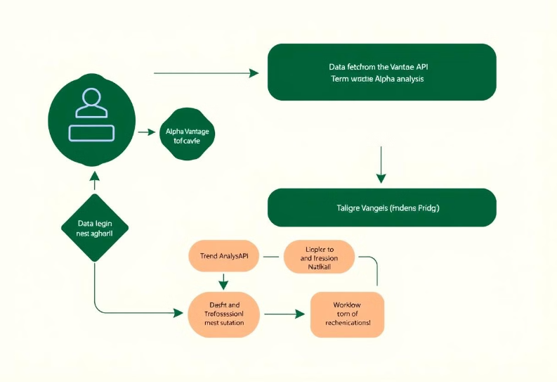
Class Diagram
Flowchart

Slide 6
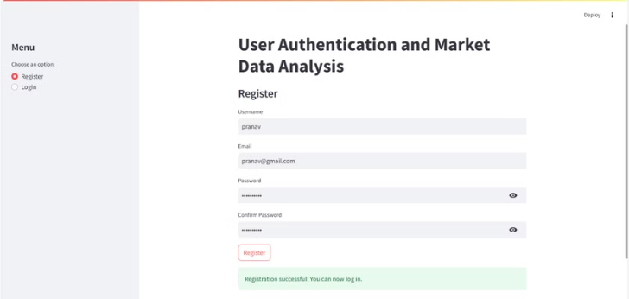
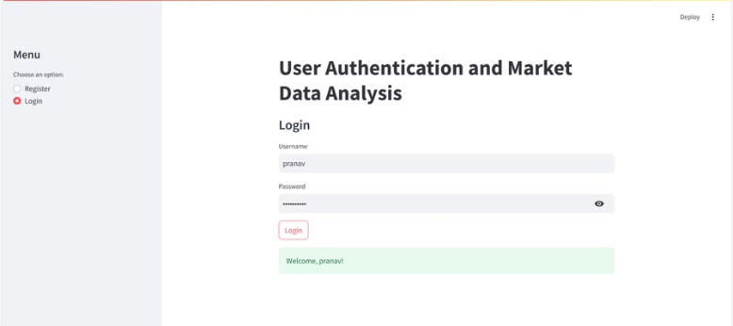
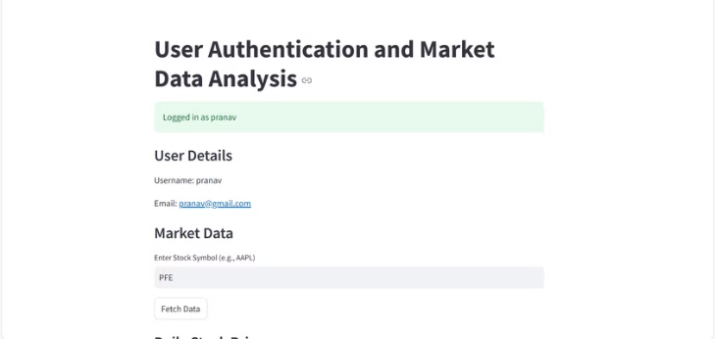
User Authentication & Registration Page

Slide 7
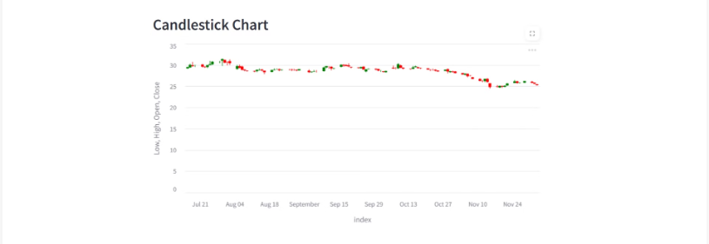
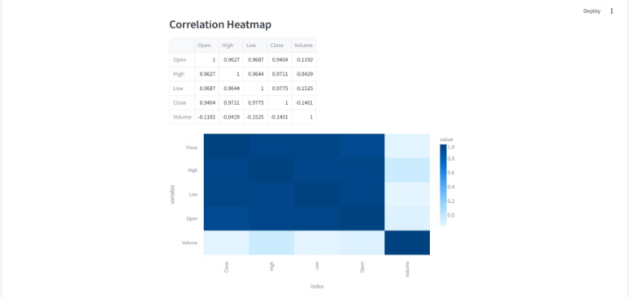
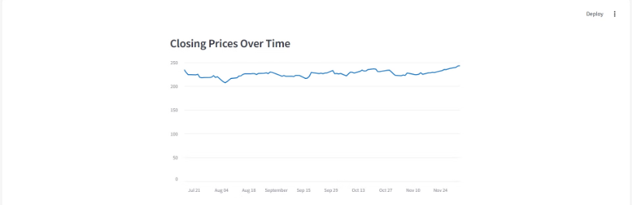
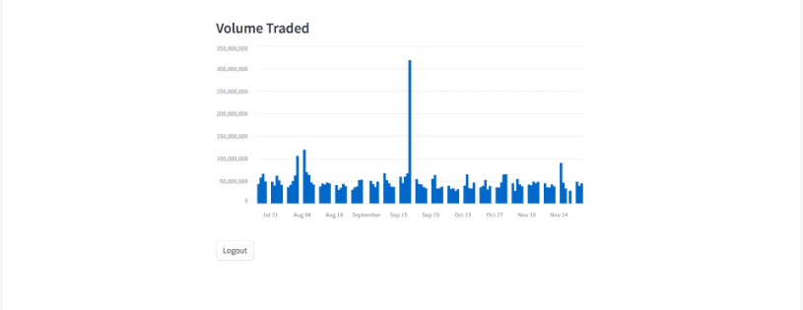
Market Trends Interface:

Slide 8
Charts in Market Trends Analysis Interface
Candlestick Chart
Purpose: Visualizes stock price movements (open, high, low, close) to identify trends and patterns crucial for technical analysis.
Relevance: Essential for traders to pinpoint potential buy/sell signals and key price levels.
Correlation Heatmap
Purpose: Shows relationships between different stocks or indicators through a color-coded matrix.
Relevance: Helps identify diversified investment opportunities and spot positively correlated sectors.
Closing Prices Over Time
Purpose: Tracks the daily closing prices of a stock over a customizable period.
Relevance: Facilitates performance monitoring, trend identification, and pattern recognition for informed decision-making.
Trading Volume
Purpose: Displays the volume of shares traded, indicating market activity and liquidity.
Relevance: Provides insights into potential market momentum shifts and helps detect unusual trading patterns.

Slide 9
Conclusion
Achievements & Future Enhancements
Enhanced Security: Implemented robust hashed password authentication for user credentials.
1
2
Market Data Integration: Successfully integrated real-time financial data using the Alpha Vantage API.
Actionable Insights: Provided intuitive visualizations for efficient stock trend analysis and informed decision-making.
3
4
Multi-Factor Authentication: Enhance security with multi-factor authentication for stronger user protection.
Advanced Analytics: Integrate predictive modeling and sentiment analysis for deeper market insights.
5
6
Expanded Data Sources: Integrate with additional APIs to broaden financial data coverage and include diverse industry trends.
Tools Used
Streamlit | SQLite | Pandas | Alpha Vantage API

Slide 10
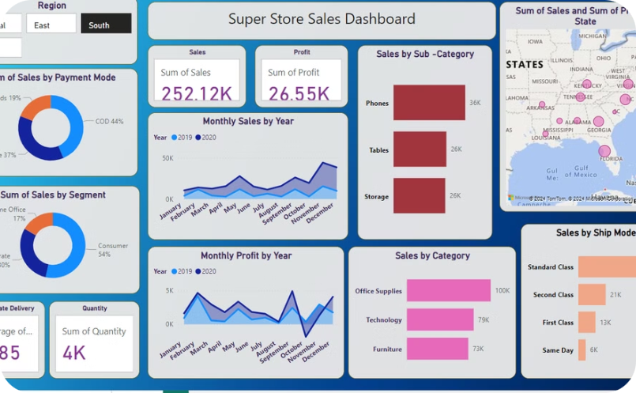
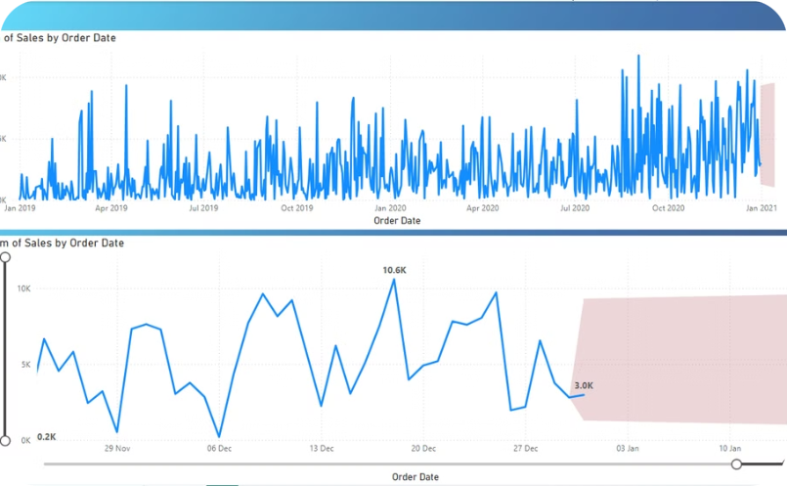
Milestone 3
Module 4: Search and Comparative Analysis Service
Power BI Dashboard
Sales Forecasting
Developed a Power BI dashboard for the Superstore dataset of the United States (2019-2020).
Conducted sales forecasting using time series analysis to derive actionable insights for the business.

Slide 11
Superstore Sales Dashboard and Insights
Objective: To leverage data analysis, specifically time series analysis, to provide valuable business insights and accurate sales forecasting, contributing to overall success.
252.12K
26.55K
Total Sales
Total Profit
Generated through an interactive Power BI dashboard built using 2019-2020 Superstore sales data.
Derived from the comprehensive sales data within the dashboard, and filtered by region, category, and payment modes.
3.85
4K
Avg. Delivery Days
Total Quantity
Reflecting the efficiency of delivery processes as showcased in the dashboard.
The total number of units sold. Data available within the interactive Power BI dashboard.

Slide 12
Insights Provided
Sales by Region
Payment Modes
Segment Performance
Southern region achieved the highest sales.
Cash on Delivery (COD): 44%
Consumer segment contributed 54% of total sales.
Online Payments: 37%
Card Payments: 19%
Product Categories
Shipping Mode
Technology led sales (100K), followed by Office Supplies and Furniture.
Standard Class preferred for 48% of shipments.

Slide 13
Trends and Time Series Analysis
Key Trends
1
Monthly sales and profit trends show peak sales in Q4 (October-December).
Time series analysis forecasted the next 15 days' sales (~3K).
2
Recommendations
Increase marketing efforts in high-performing regions (e.g., South).
Focus promotions on Technology products during Q4.
Optimize inventory for peak shipping modes and periods.
Tools Used:
Power BI: For dashboard design and visualization.
Time Series Analysis: For forecasting trends based on historical data.

Slide 14
Team Members:
Harshith Sai
Dumpati Ravali
Vanishree Srinivas

